Slide 1
Warm Up: Complete in your notes and be prepared to share.
It is true that h(32) = 1
What does that mean in physical terms?
It is true that h(212)=10
What does that mean in physical terms?
Describe the inverse function $h^{−1}$. What are its inputs? What are its outputs? What does it measure?
Hospitals used to use a device that measured the function $h^{−1}$. Some people used to have such a device in their homes. What is the name of this device?

Slide 2
To the White Boards!

Slide 3
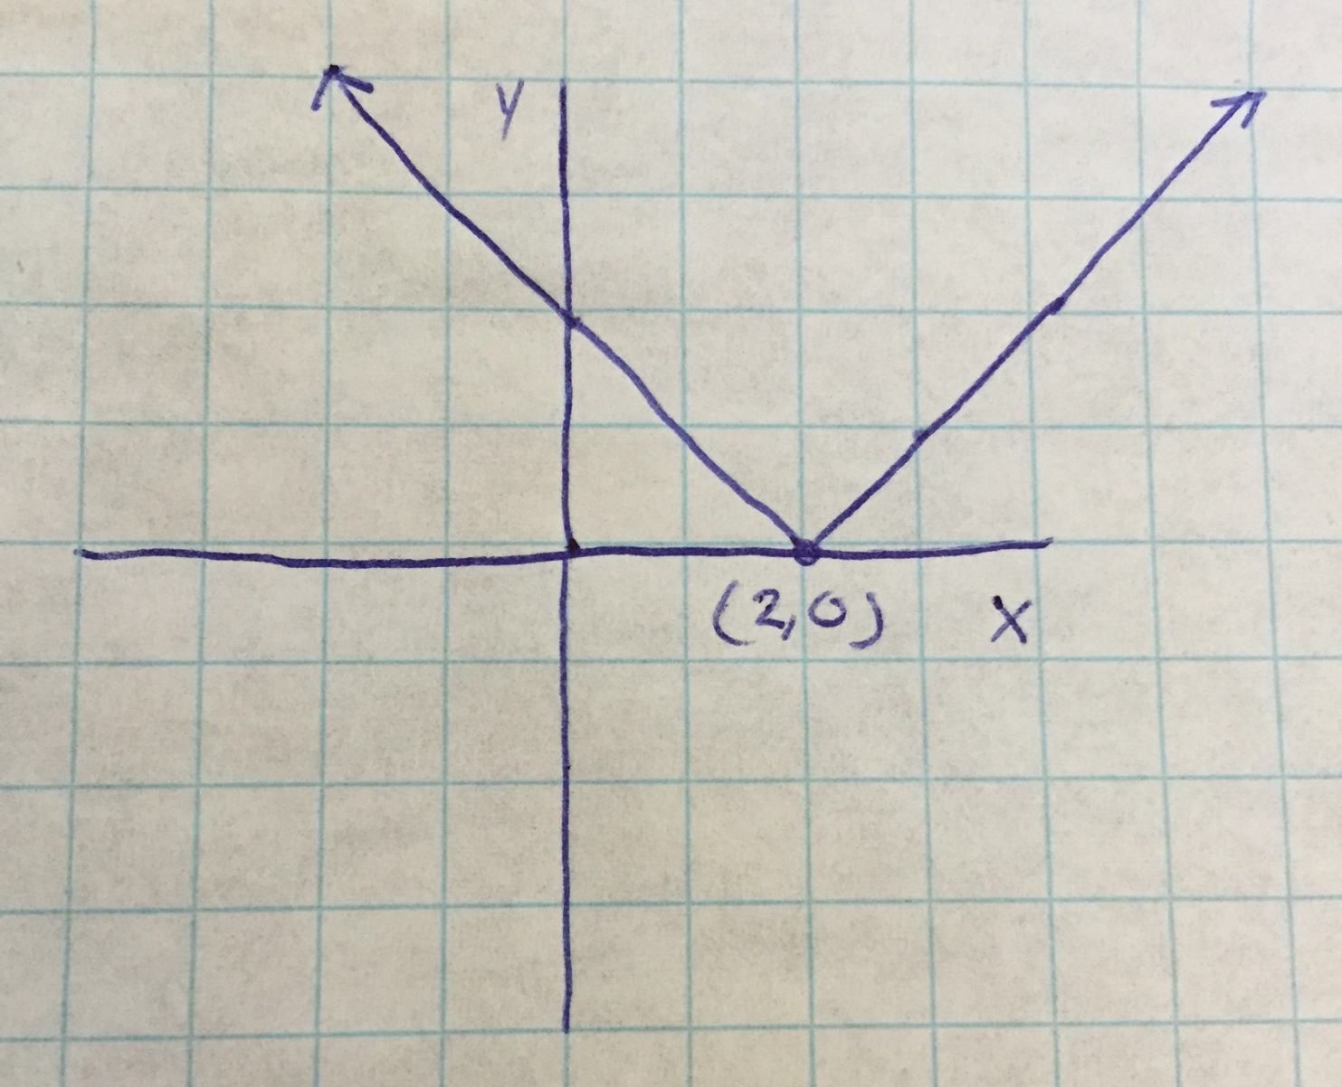
$$f(x)=\left|x−2\right|$$
Notes:
Absolute Value shift to the right 2

Slide 4
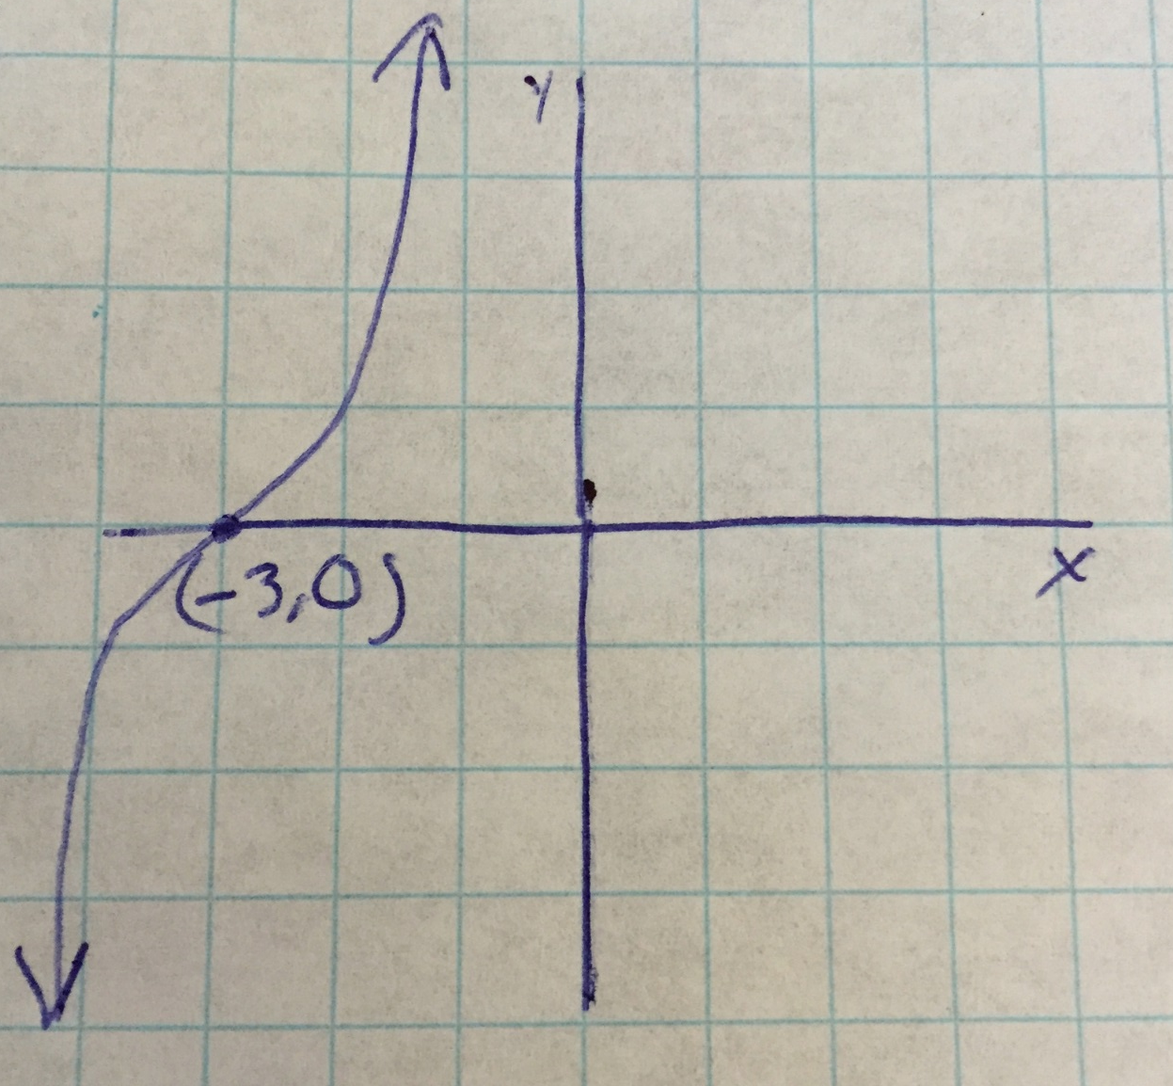
$$g(x)= {\left(x+3\right)}^{3}$$
Notes:
Cubic shift to the left 3

Slide 5
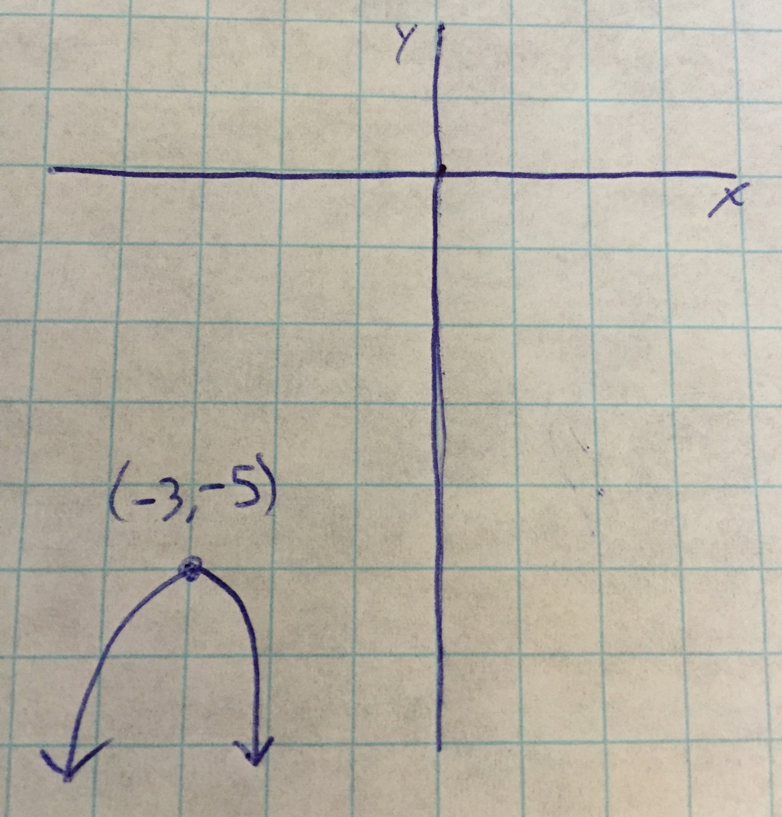
$$h(x)=−{\left(x+3\right)}^{2}−5$$
Notes:
Parabola shifted left 3, down 5 and reflected across y=-5

Slide 6
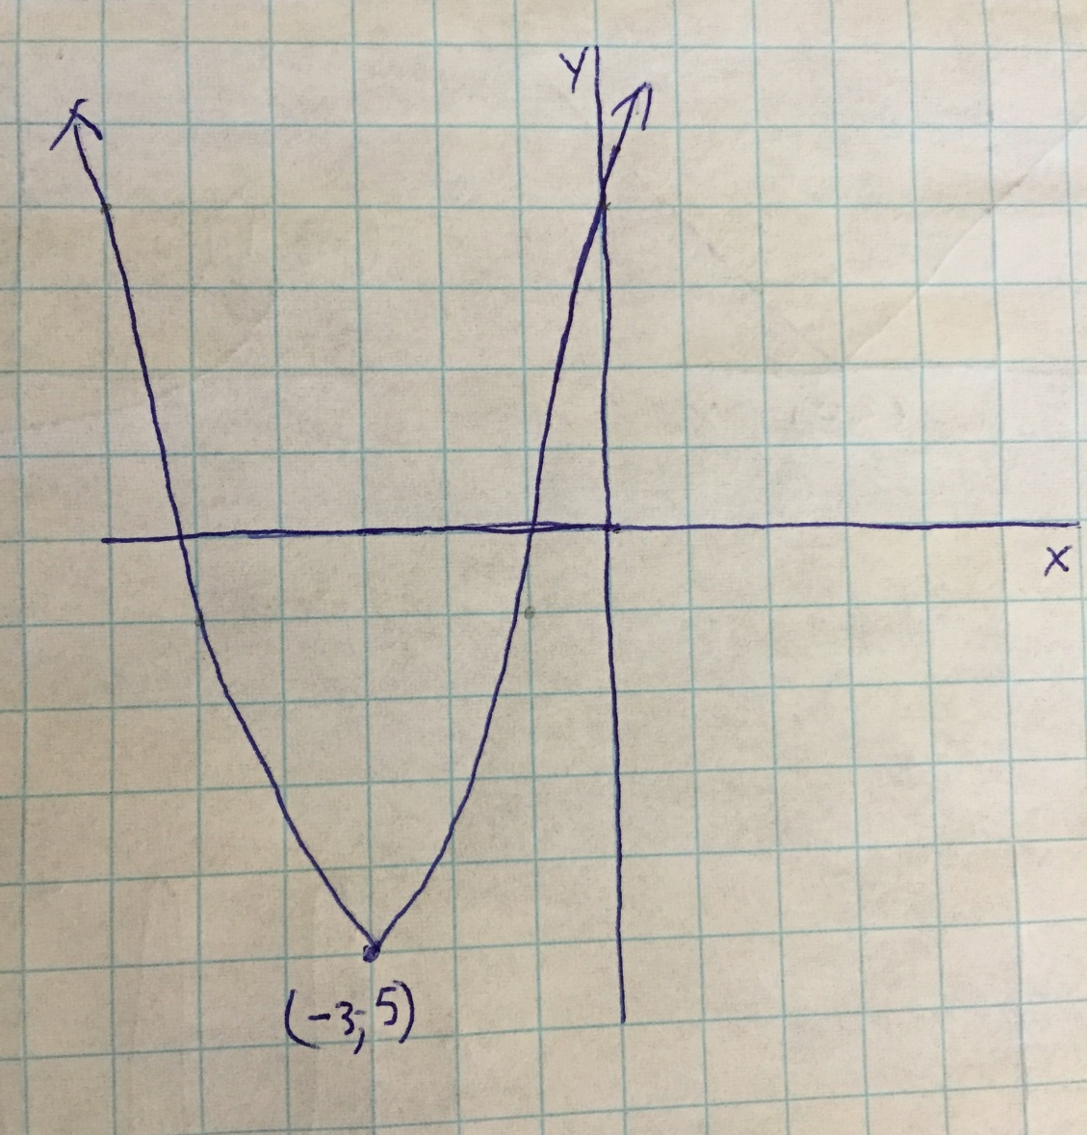
$$y=x^{2}+6x+4$$
Notes:
Parabola shifted left 3, down 5

Slide 7
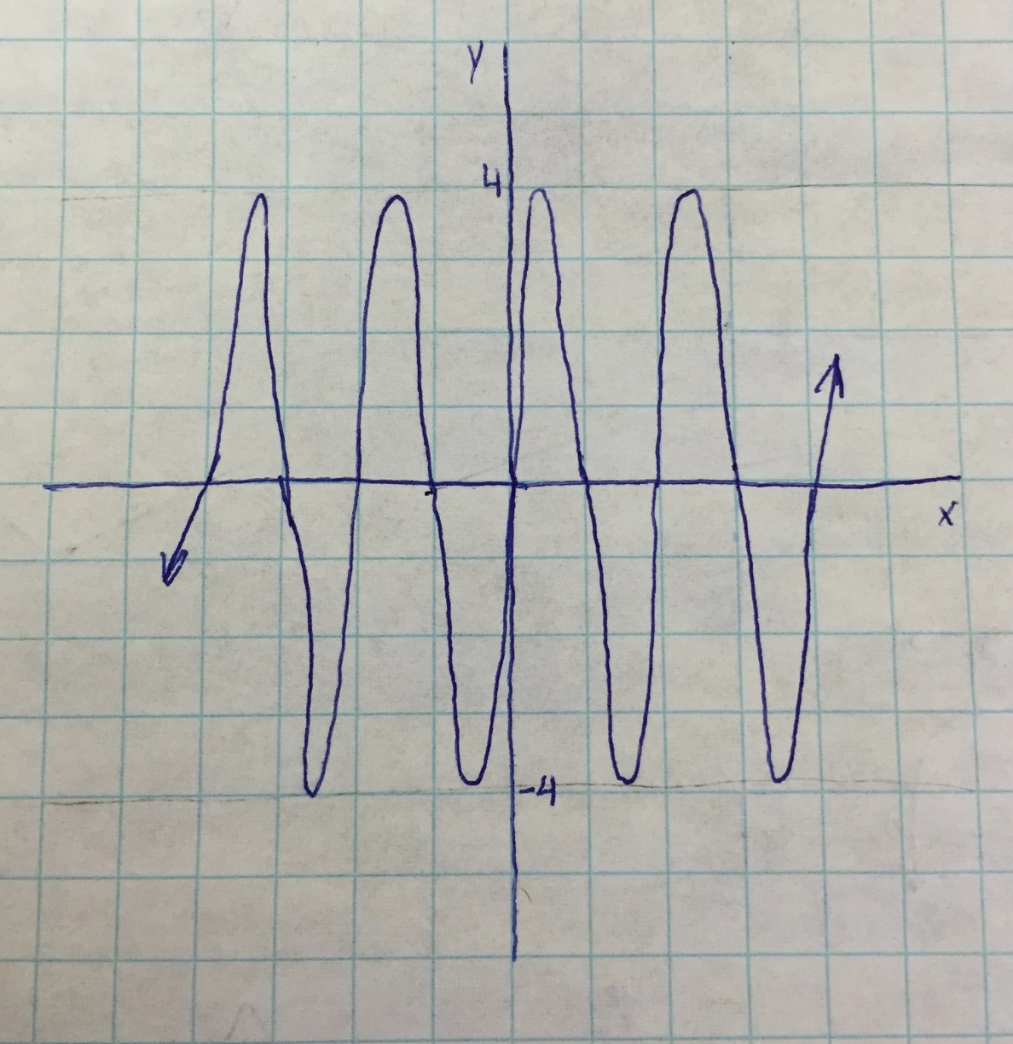
$$g\left(x\right)=4\sin{πx}$$
Notes:
Sin function that crosses x-axis at 1,2,3,4,etc and oscillates from -4 to 4

Slide 8
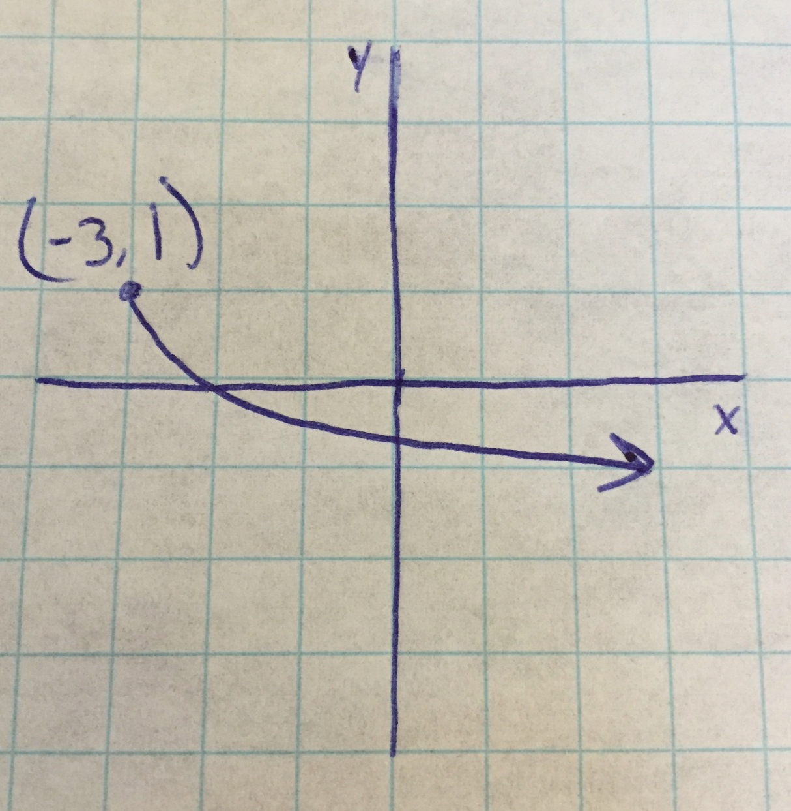
$$f\left(x\right)=1−2\sqrt{x+3}$$
Notes:
Radical shifted left 3 and up one, graph is expanded and then reflected about y=1

Slide 9
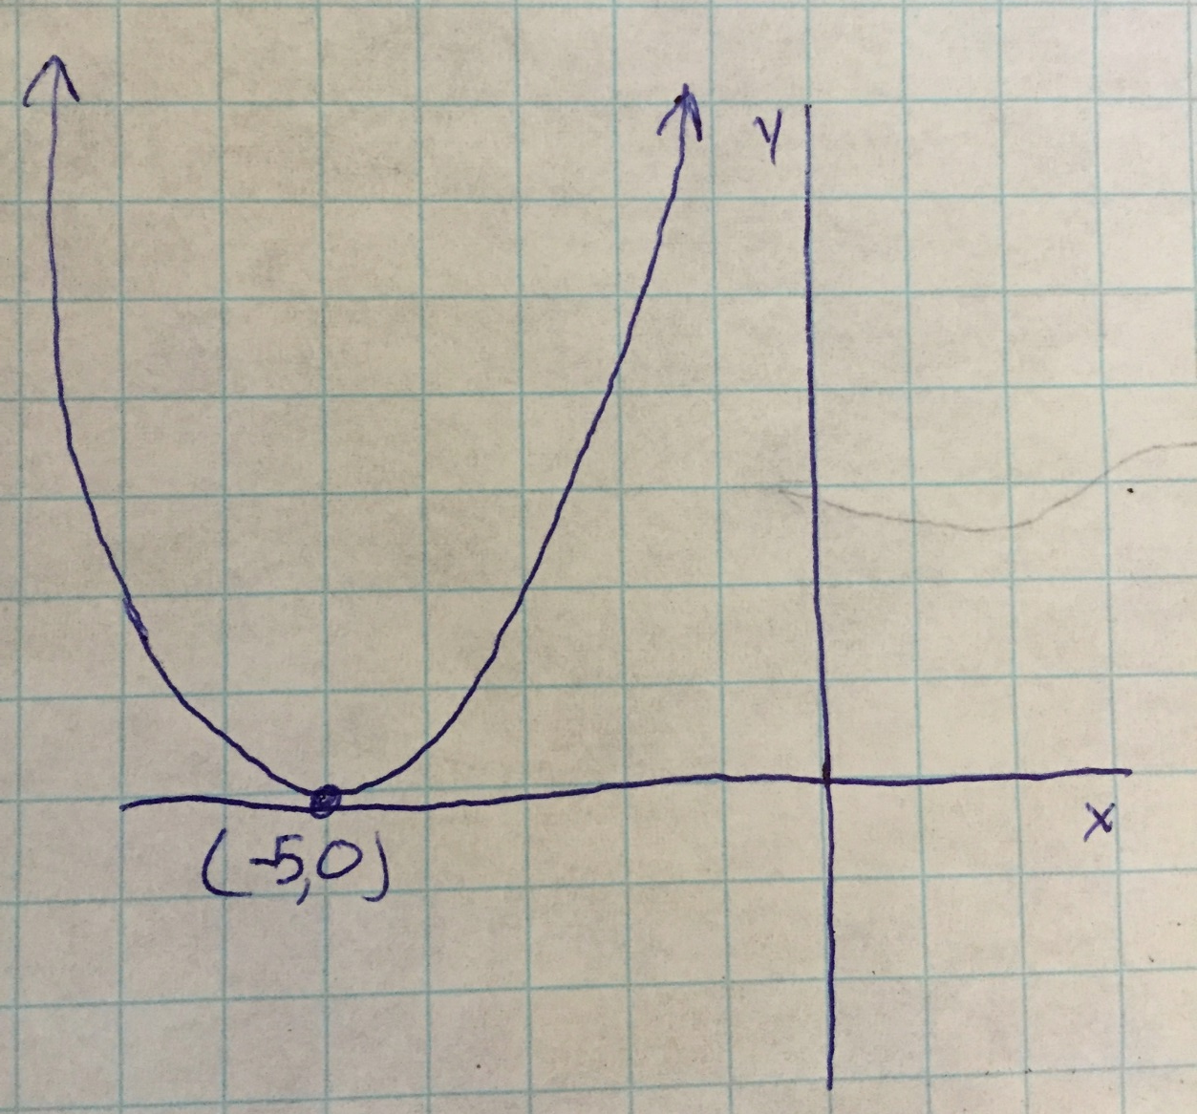
$$\sqrt{2y}−5=x$$
Notes:
Solve for y, parabola, left shift 5, widened by 2

Slide 10
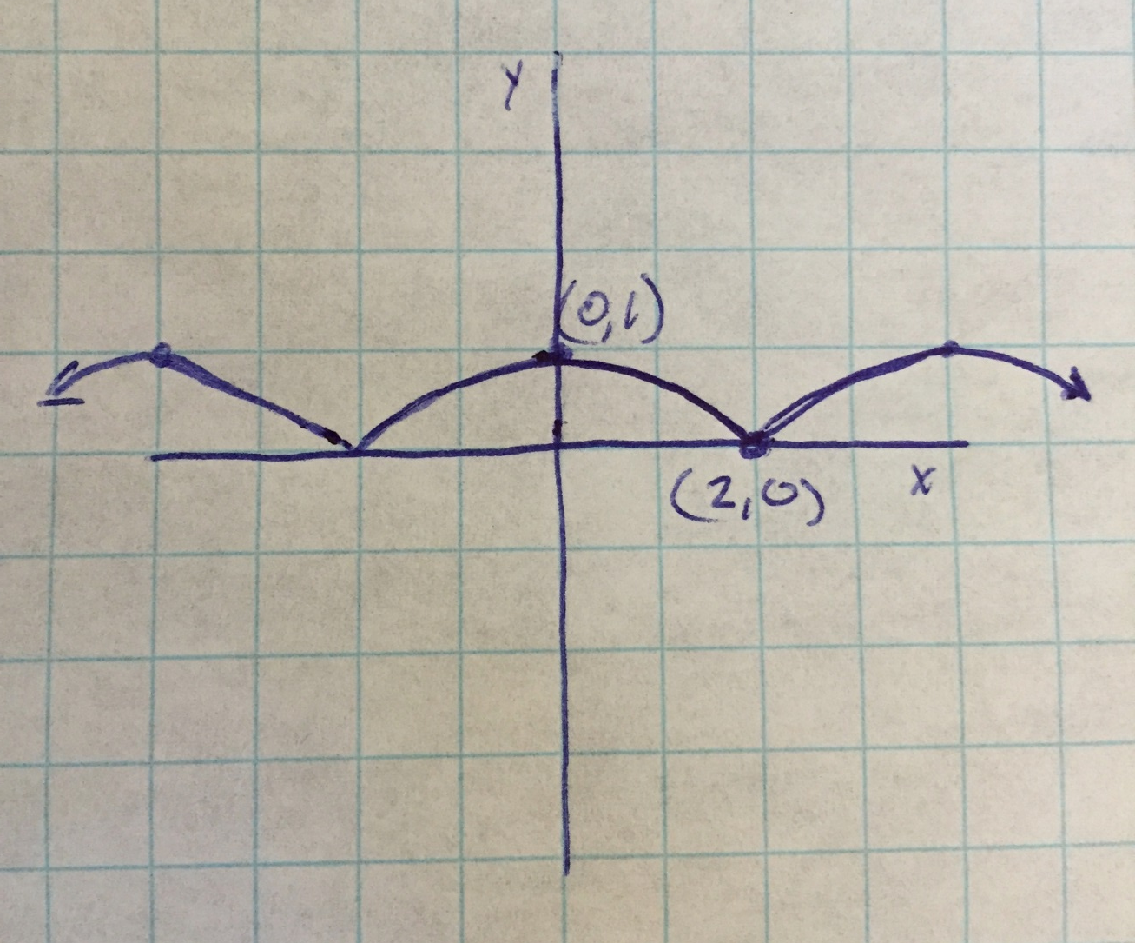
$$h\left(x\right)=\left|\cos{\frac{π}{4}}x\right|$$
Notes:
Cos function that stays positive, cross x-axis at every other even

Slide 11
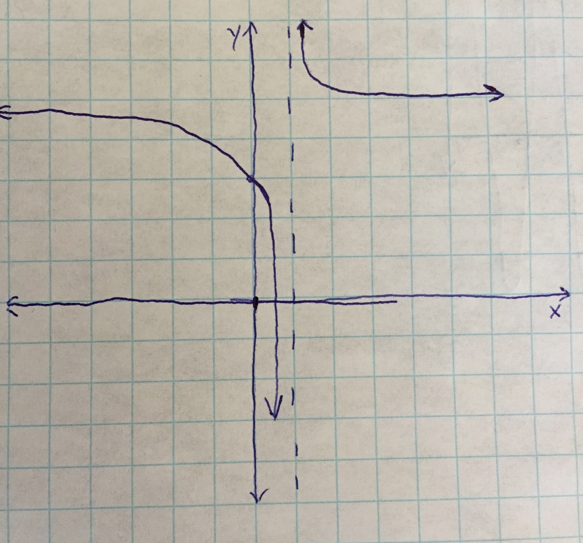
$$f\left(x\right)=\frac{2x}{(x−1)}+3$$
Notes:
Asymptote at x=1 shifted up

Slide 12
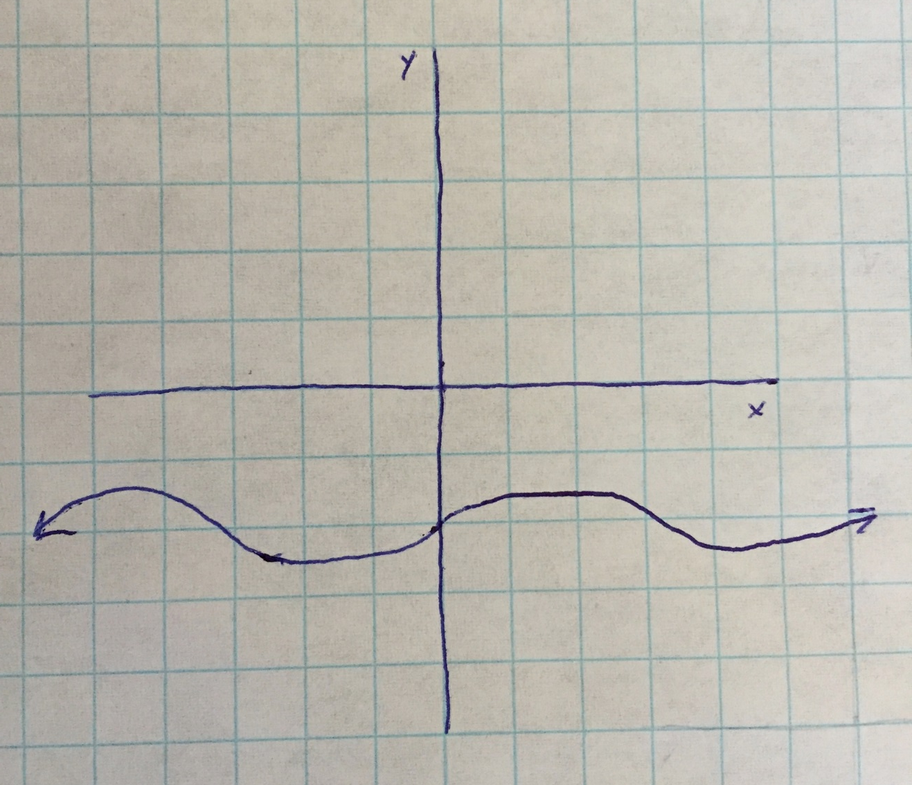
$$\frac{3(y+2)}{\cos{x}}=\tan{x}$$
Notes:
Solve for y=1/3sinx -2

Slide 13
Multiply using a Generic Rectangle! $$\left(3x^{2}−4x+7\right)\left(−y^{3}−3x+2\right)$$ Your answer needs to be simplified

Slide 14
Practice time for composition, inverses, +/-/*//
Pg 43 #37, 50, 51
Pg 70 #21, 22, 25
Pg 74 #24
Worksheet EOO

